Slide 1




Continuous Integration
What is CI, Install and Setup TeamCity
QA
Automation
SoftUni Team
Technical Trainers
Software University
http://softuni.bg

Slide 2

Table of Contents
Continuous Integration
Version Control System
Seleno
TeamCity
TeamCity Install and First Build

Slide 3
Have a Question?
sli.do #QA-Automation

Slide 4
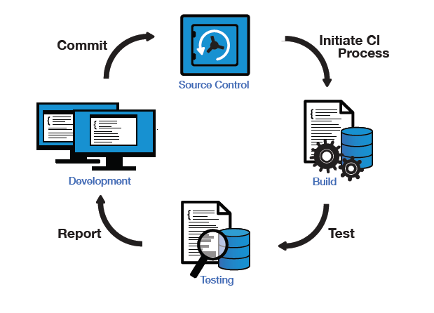
Continuous Integration

Slide 5
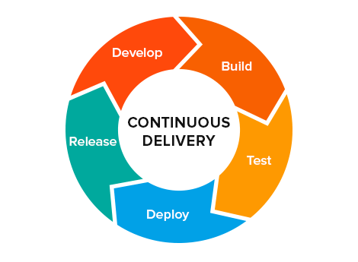
Continuous Delivery
Teams produce software in short cycles
Software can be reliably released at any time
Building, testing, and releasing software faster and more frequently

Slide 6
What is Continuous Integration?
Continuous integration (CI) is a software engineering practice in which isolated changes are immediately tested and reported on when they are added to a larger code base

Slide 7
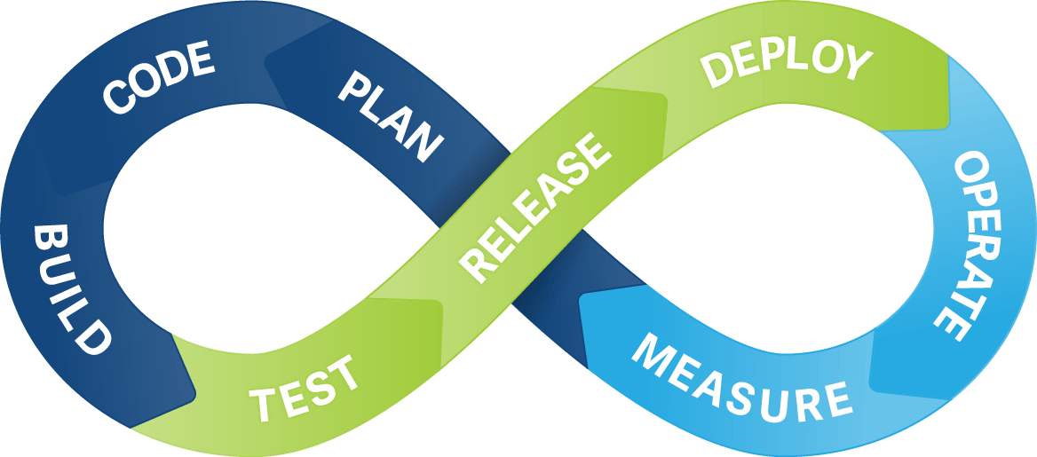
Best Practices
Maintain a code repository
Automate the build
Make the build self-testing
Everyone commits to the baseline every day
Every commit (to baseline) should be built

Slide 8
Best Practices (2)
Keep the build fast
Test in a clone of the production environment
Make it easy to get the latest deliverables
Everyone can see the results of the latest build
Automate deployment

Slide 9
How to Do It
Developers check out code into their private workspaces
When done, commit the changes to the repository
The CI server monitors the repository and checks out changes when they occur
The CI server builds the system and runs unit and integration tests
The CI server releases deployable artefacts for testing

Slide 10
How to Do It (2)
The CI server assigns a build label to the version of the code it just built
The CI server informs the team of the successful build
If the build or tests fail, the CI server alerts the team
The team fixes the issue at the earliest opportunity
Continue to continually integrate and test throughout the project

Slide 11

Version Control Systems

Slide 12


What is Git?
Git
Distributed source-control system
Work with local and remote repositories
Git Bash – command line interface for Git
Free, open-source
GitHub is the world's #1 source code hosting site
Free for open-source projects
Paid plans for private projects

Slide 13
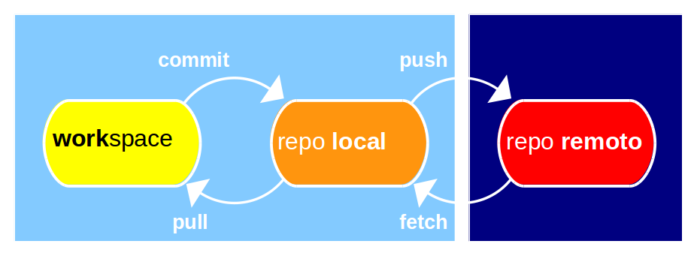
Git: How It Works?
Local computer (your laptop)
Remote repository (e.g. GitHub.com)

Slide 14
Git and GitHub Terminology
Repository (repo)
Keeps your project files (local and remote repo)
Clone a remote repository
Download a working copy from GitHub to your computer
Commit changes
Save your changed files to the local repository (not in GitHub!)
Sync (synchronize changes)
Pull from GitHub – download (fetch) latest changes & merge them
Push to remote repository – upload the changes to GitHub

Slide 15
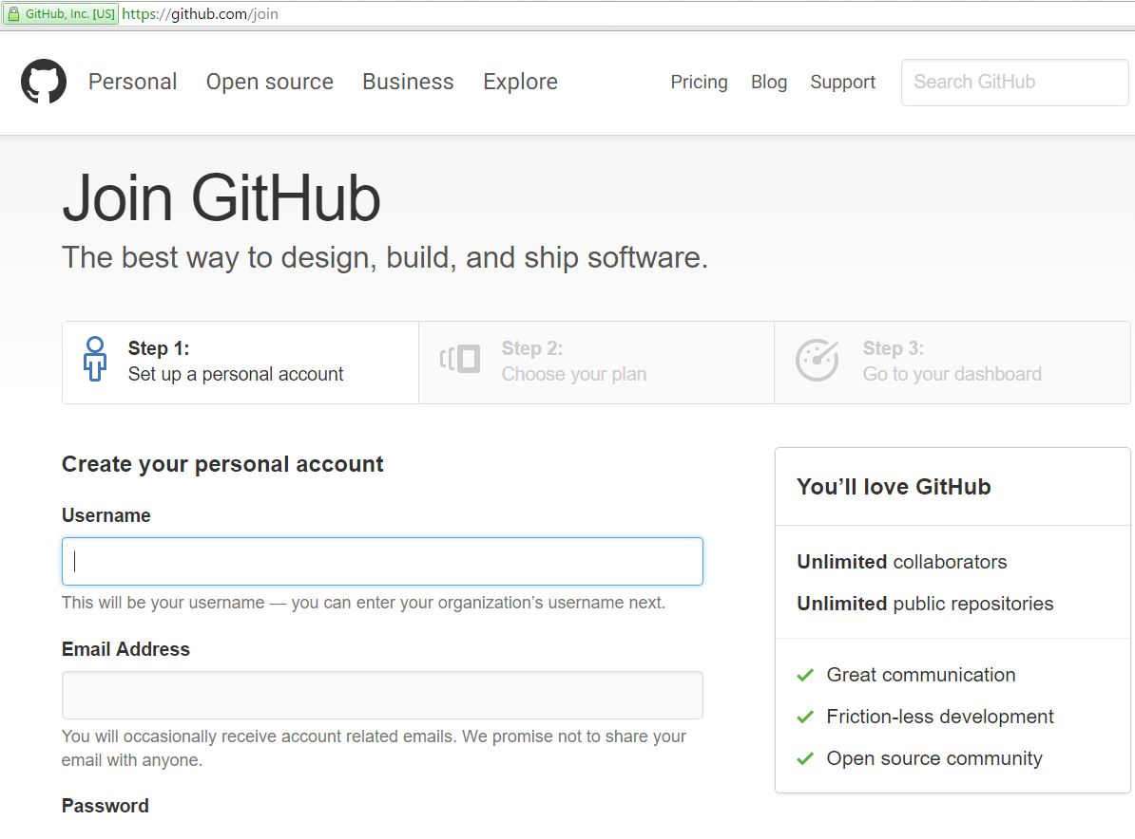
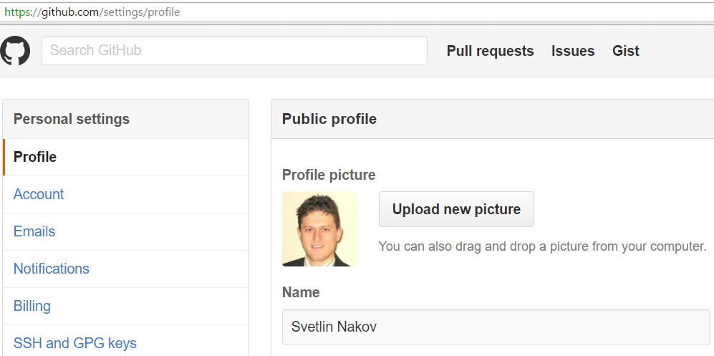
Exercise: Create Your Own Profile at GitHub
Create a GitHub account at https://github.com

Slide 16
TeamCity
Install and First Setup

Slide 17
What is TeamCity?
TeamCity is a Java-based build management and continuous integration server from Jet Brains
Freemium license for up to 20 build configurations and 3 free Build Agent licenses is available
Open Source projects can request a free license

Slide 18
TeamCity Features
Integrated code coverage, inspections and duplicates search
Integration with IDEs: Eclipse, IntelliJ IDEA, Visual Studio
Platforms supported: Java, .NET and Ruby

Slide 19
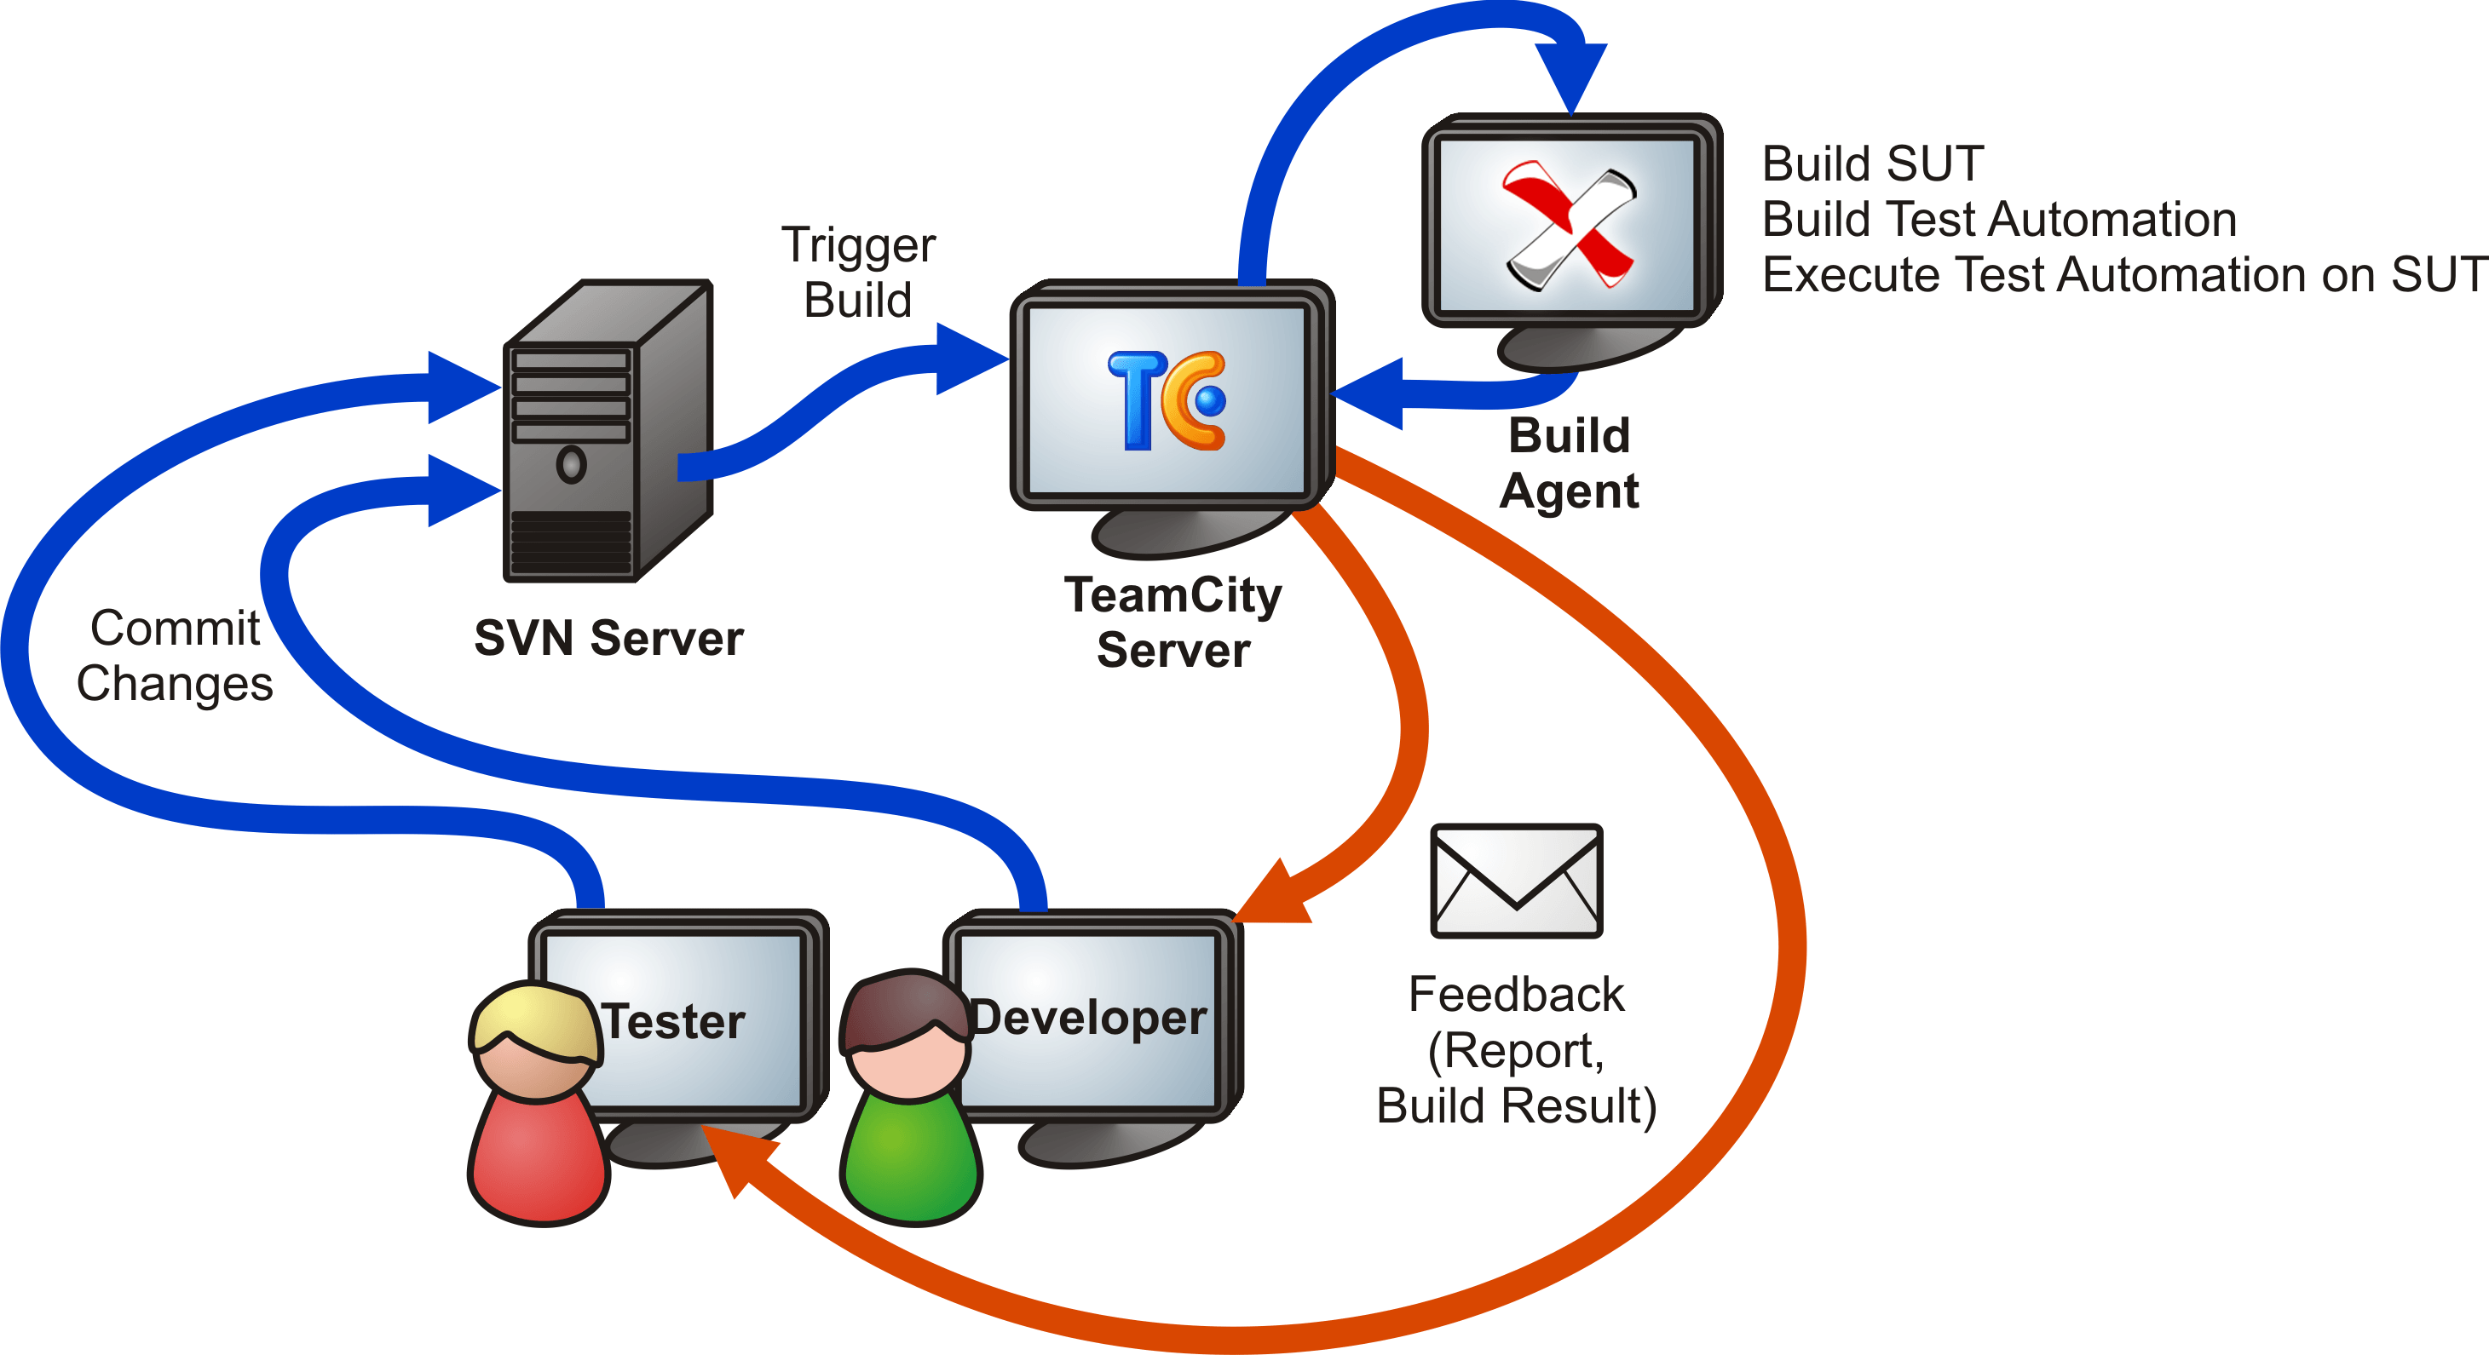
TeamCity Diagram

Slide 20
TeamCity Set Up Steps
Value of Continuous Integration
Infrastructure
TeamCity Server
TeamCity Build Agent
Version Control System

Slide 21
TeamCity Set Up Steps (2)
Add a new Project
Version Control Settings
Build Steps
Build Triggers
Configure Notifications
Run Job
Conclusion

Slide 22

Summary
Continuous Integration
Version Control System
Seleno
TeamCity
TeamCity Install and First Build

Slide 23








Selenium WebDriver Design Patterns
https://www.w3schools.com/xml/xpath_axes.asp

Slide 24
License
This course (slides, examples, demos, videos, homework, etc.) is licensed under the "Creative Commons Attribution-NonCommercial-ShareAlike 4.0 International" license

Slide 25





Free Trainings @ Software University
Software University Foundation – softuni.org
Software University – High-Quality Education, Profession and Job for Software Developers
softuni.bg
Software University @ Facebook
facebook.com/SoftwareUniversity
Software University @ YouTube
youtube.com/SoftwareUniversity
Software University Forums – forum.softuni.bg

